Slide 1
COEN 243: Programming Methodology I Lecture 4: Control Flow II

Slide 2
5.1 Introduction
for, do…while and switch statements.
counter-controlled repetition.
Expand the GradeBook class presented in Chapters 3–4.
Introduce the break and continue program control statements.
Logical operators for more powerful conditional expressions.
Examine the common error of confusing the equality (==) and assignment (=) operators, and how to avoid it.
Summarize C++’s control statements.

Slide 3
5.2 Essentials of Counter-Controlled Repetition
Counter-controlled repetition requires
the name of a control variable (or loop counter)
the initial value of the control variable
the loop-continuation condition that tests for the final value of the control variable (i.e., whether looping should continue)
the increment (or decrement) by which the control variable is modified each time through the loop.

Slide 4
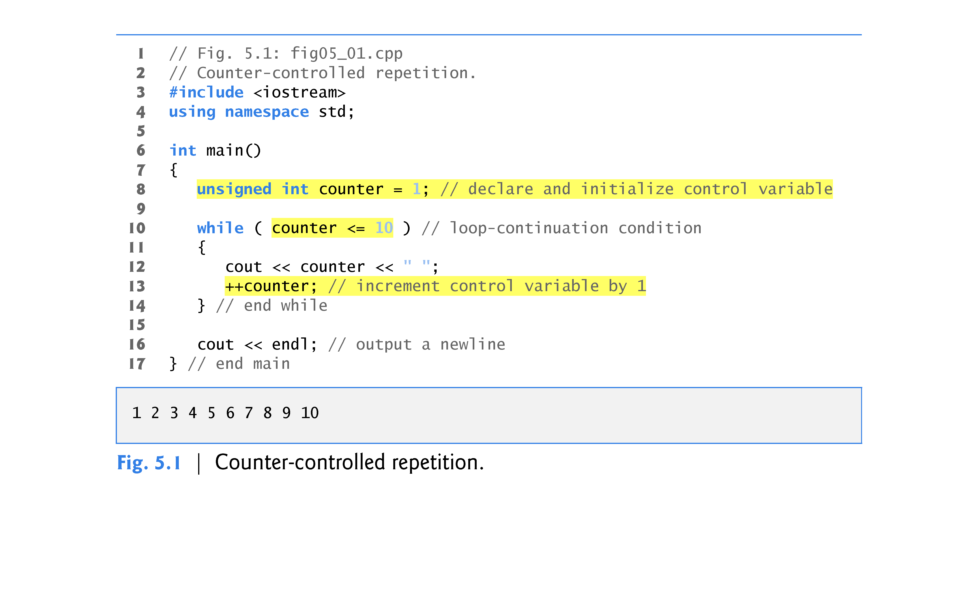

Slide 5
5.3 for Repetition Statement
The for repetition statement specifies the counter-controlled repetition details in a single line of code.
To illustrate the power of for, let’s rewrite the program of Fig. 5.1. The result is shown in Fig. 5.2.
The initialization occurs once when the loop is encountered.
The condition is tested next and each time the body completes.
The body executes if the condition is true.
The increment occurs after the body executes.
Then, the condition is tested again.
If there is more than one statement in the body of the for, braces are required to enclose the body of the loop.

Slide 6
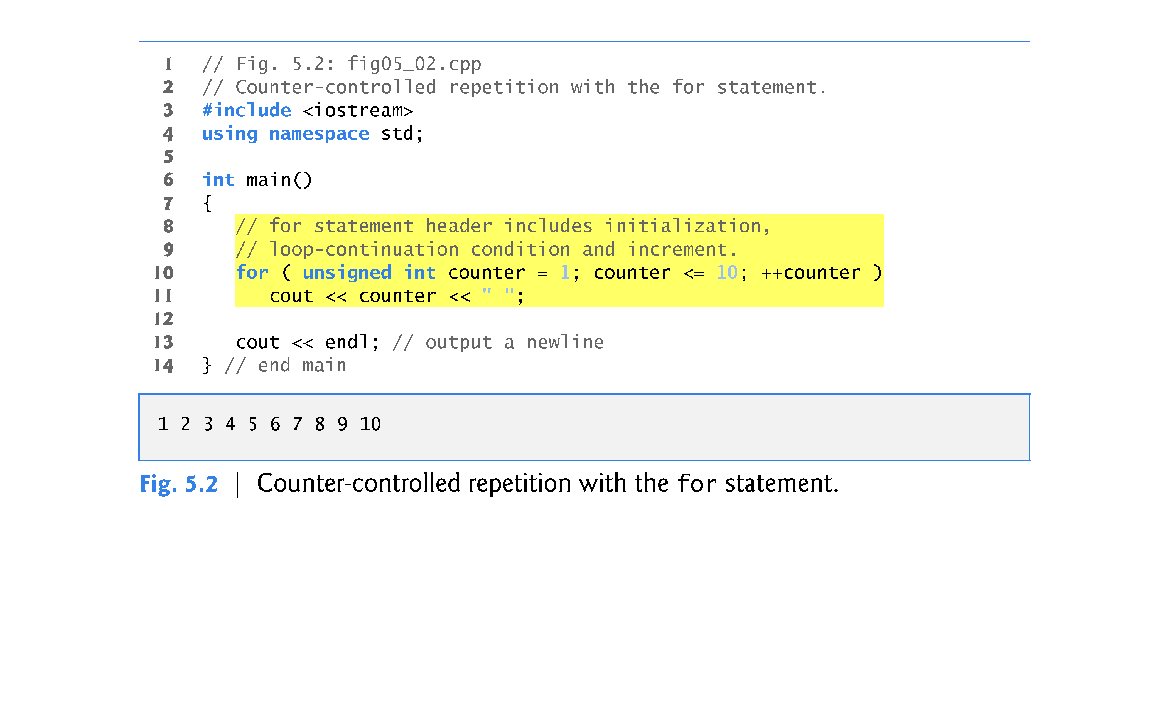

Slide 7
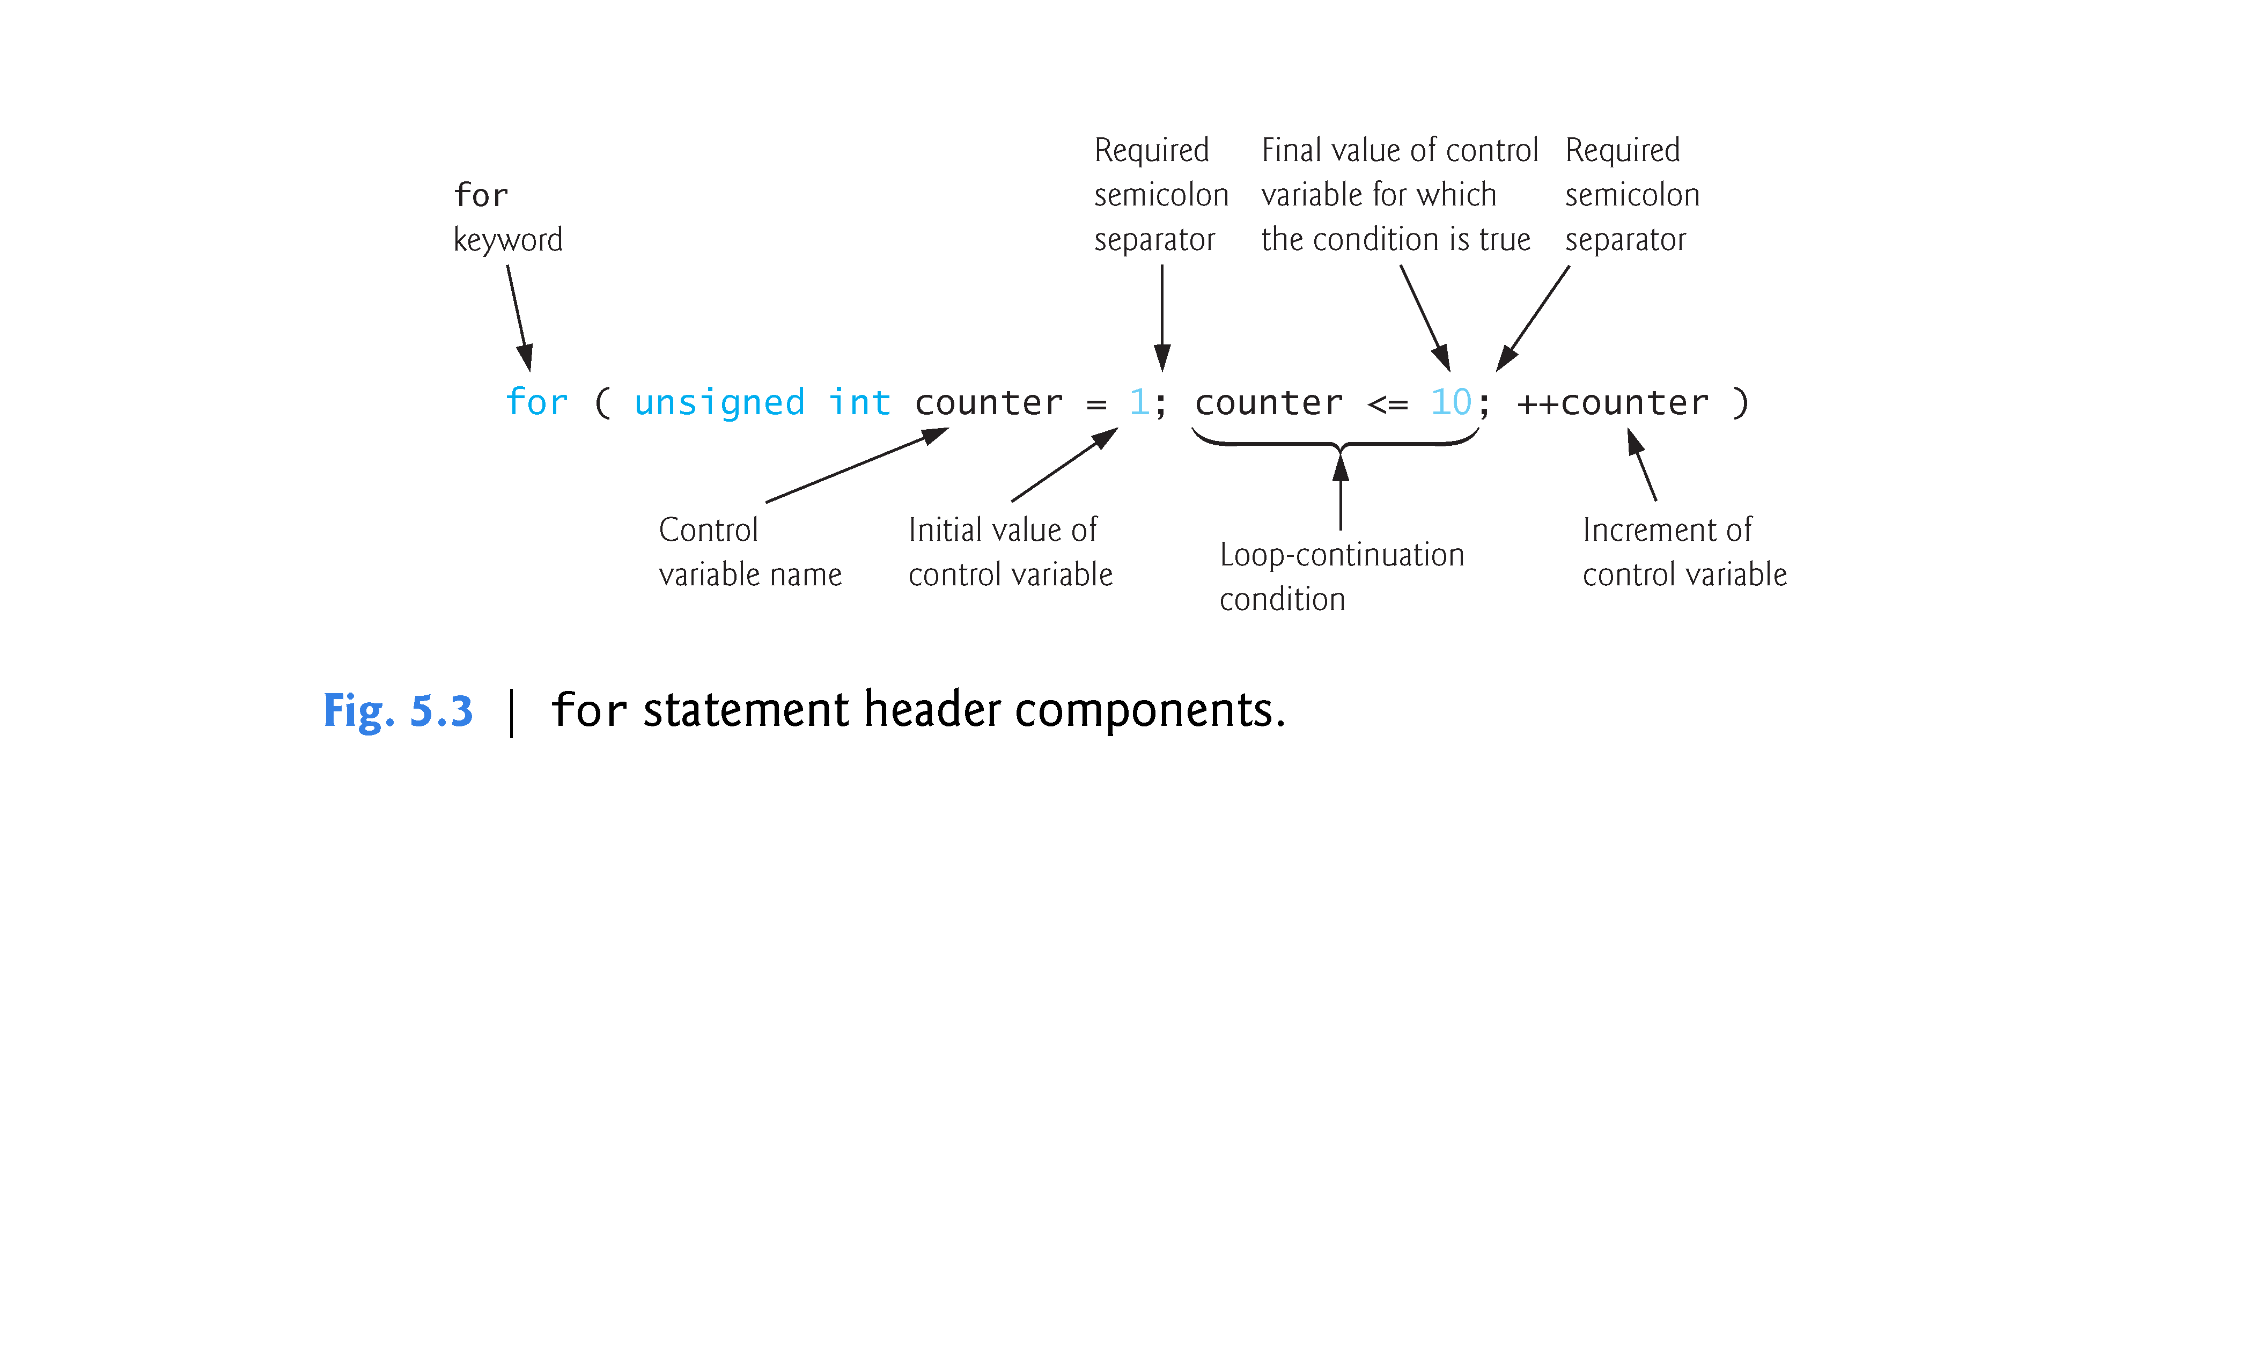

Slide 8
5.3 for Repetition Statement (cont.)
General Format of a for Statement
The general form of the for statement is
for ( initialization; loopContinuationCondition; increment ) statement
where the initialization expression initializes the loop’s control variable, loopContinuationCondition determines whether the loop should continue executing and increment increments the control variable.
In most cases, the for statement can be represented by an equivalent while statement, as follows:
initialization; while ( loopContinuationCondition ) { statement increment; }

Slide 9
5.3 for Repetition Statement (cont.)
If the initialization expression declares the control variable, the control variable can be used only in the body of the for statement—the control variable will be unknown outside the for statement.
This restricted use of the control variable name is known as the variable’s scope.
The scope of a variable specifies where it can be used in a program.

Slide 10
5.3 for Repetition Statement (cont.)
Comma-Separated Lists of Expressions
The initialization and increment expressions can be comma-separated lists of expressions.
The commas, as used in these expressions, are comma operators, which guarantee that lists of expressions evaluate from left to right.
The lowest precedence of all C++ opera-tors.
The value and type of a comma-separated list of expressions is the value and type of the rightmost expression.

Slide 11
5.3 for Repetition Statement (cont.)
Expressions in the for Statement’s Header Are Optional
The three expressions in the for statement header are optional (but the two semicolon separators are required).
If the loopContinuationCondition is omitted, C++ assumes that the condition is true, thus creating an infinite loop.
One might omit the initialization expression if the control variable is initialized earlier in the program.
One might omit the increment expression if the increment is calculated by statements in the body of the for or if no increment is needed.

Slide 12
5.3 for Repetition Statement (cont.)
Increment Expression Acts Like a Standalone Statement
The increment expression in the for statement acts like a standalone statement at the end of the for statement’s body.
The expressions
counter = counter + 1 counter += 1 ++counter counter++
are all equivalent in the increment expression (when no other code appears there).

Slide 13
5.4 Examples Using the for Statement
Vary the control variable from 1 to 100 in increments of 1.
for ( unsigned int i = 1; i <= 100; ++i )
Vary the control variable from 100 down to 0 in decrements of 1. Notice that we used type int for the control variable in this for header. The condition does not become false until control variable i contains -1, so the control variable must be able to store both positive and negative numbers.
for ( int i = 100; i >= 0; --i )
Vary the control variable from 7 to 77 in steps of 7.
for (unsigned int i = 7; i <= 77; i += 7 )
Vary the control variable from 20 down to 2 in steps of -2.
for (unsigned int i = 20; i >= 2; i -= 2 )

Slide 14
5.4 Examples Using the for Statement (cont.)
Vary the control variable over the following sequence of values: 2, 5, 8, 11, 14, 17.
for (unsigned int i = 2; i <= 17; i += 3 )
Vary the control variable over the following sequence of values: 99, 88, 77, 66, 55.
for (unsigned int i = 99; i >= 55; i -= 11 )

Slide 15
5.4 Examples Using the for Statement (cont.)
Application: Summing the Even Integers from 2 to 20
The program of Fig. 5.5 uses a for statement to sum the even integers from 2 to 20.

Slide 16
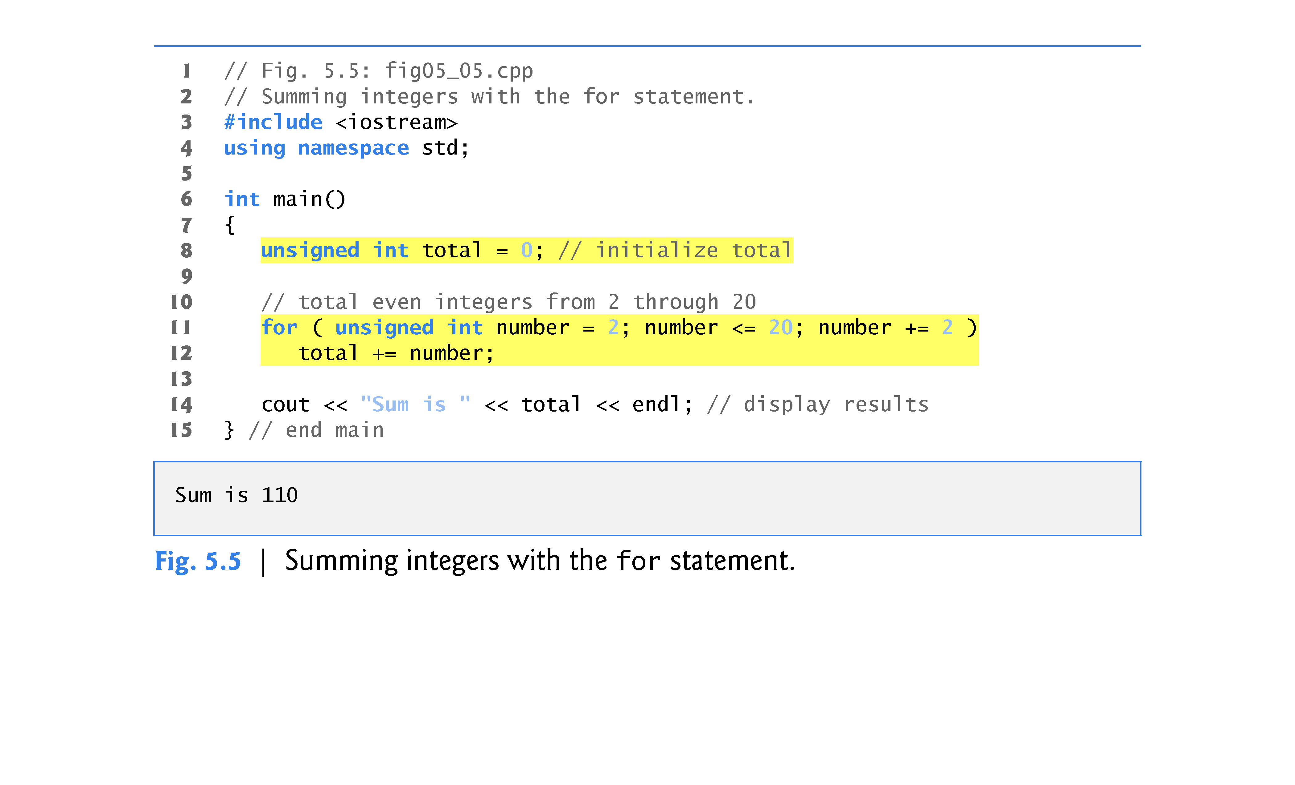

Slide 17
5.5 do…while Repetition Statement
Similar to the while statement.
The do…while statement tests the loop-continuation condition after the loop body executes; therefore, the loop body always executes at least once.
Figure 5.7 uses a do…while statement to print the numbers 1–10.

Slide 18
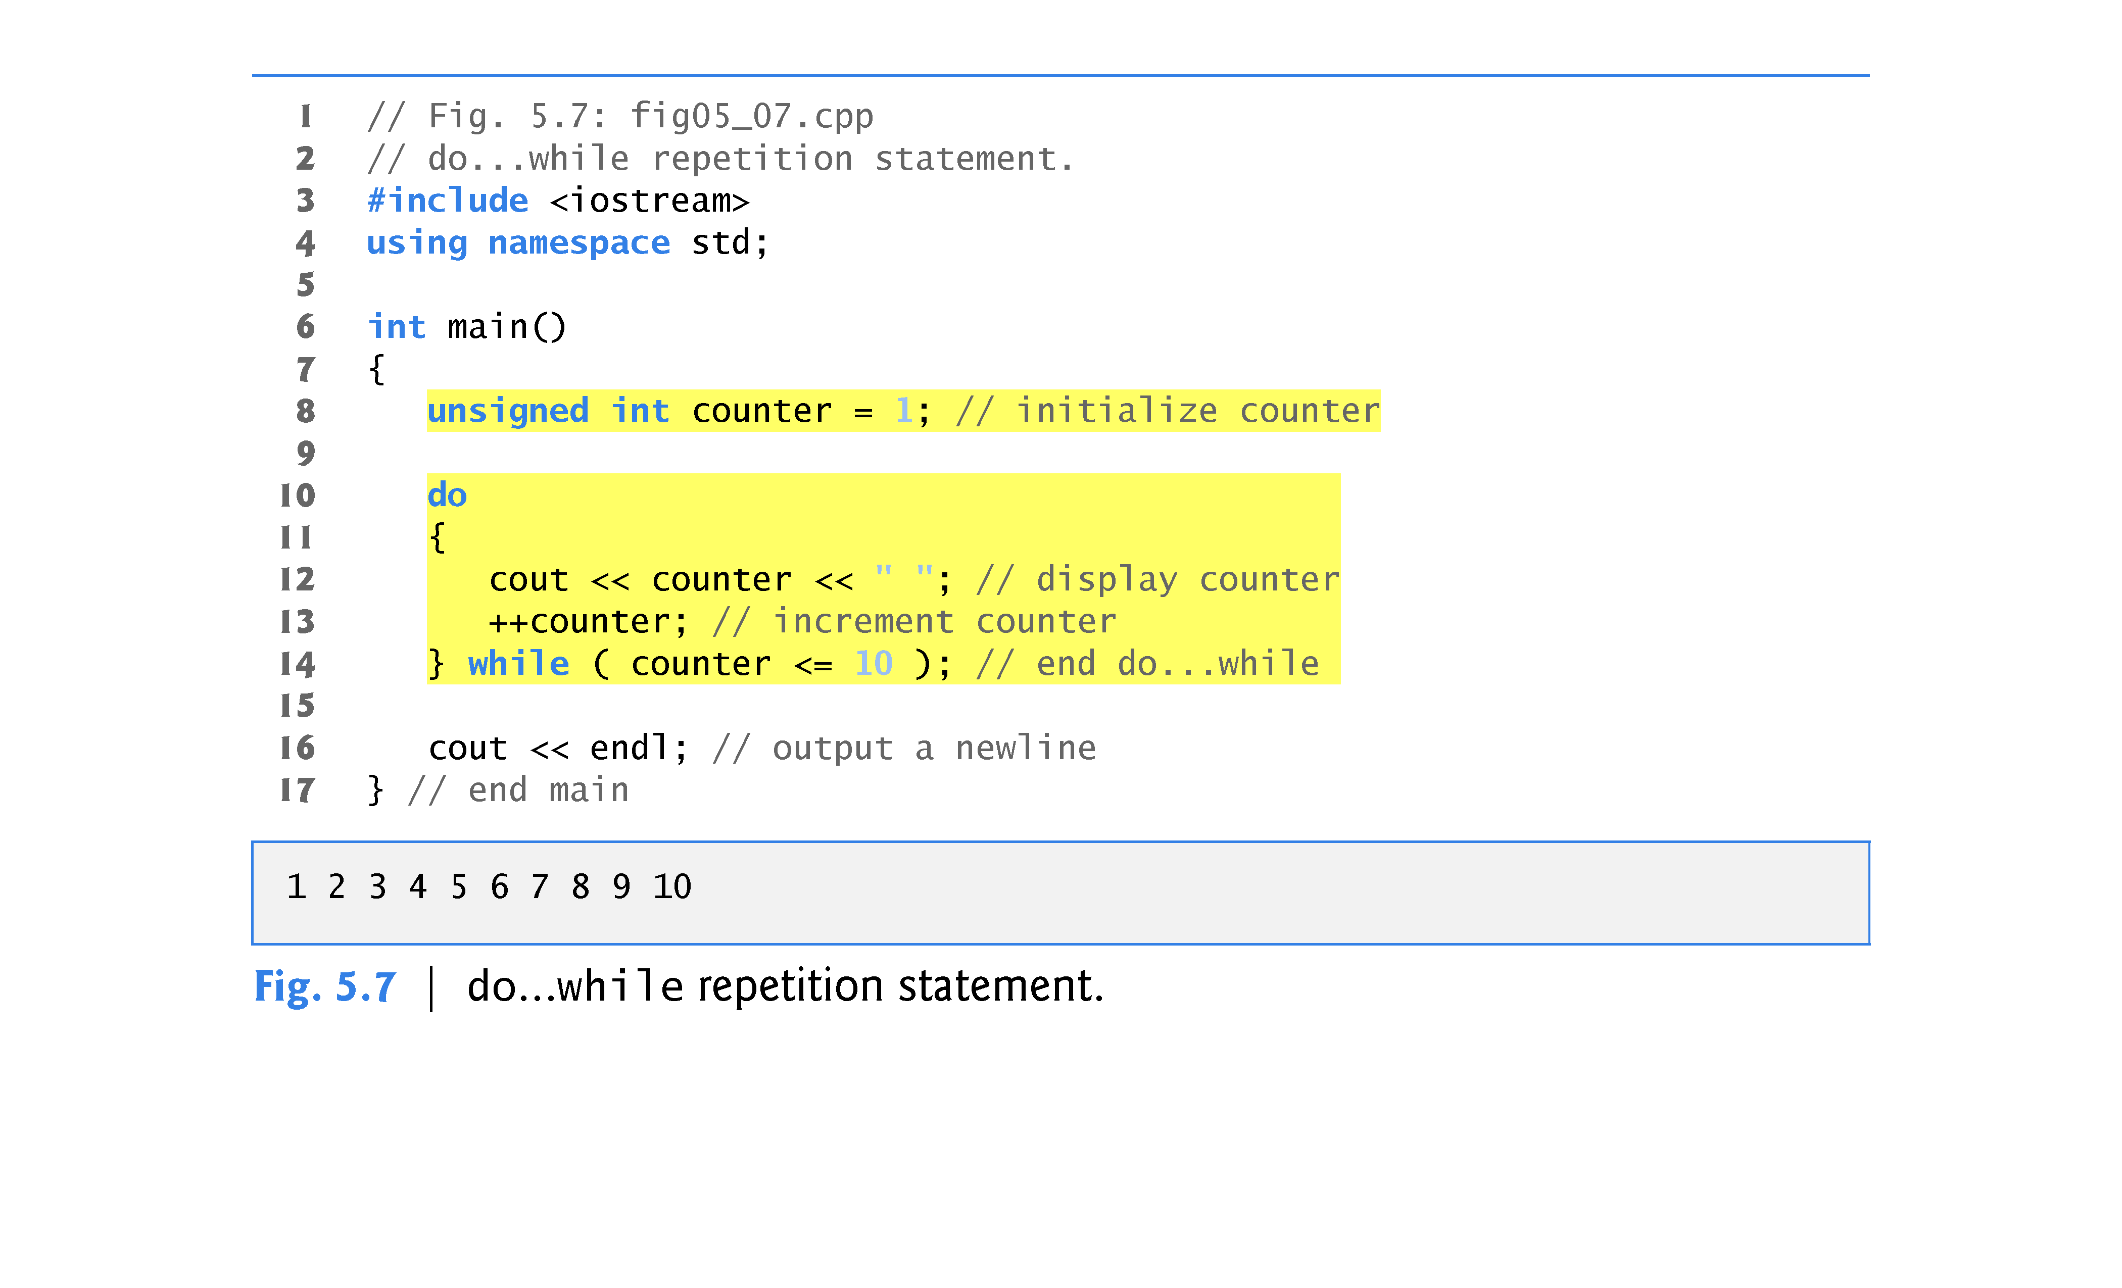

Slide 19
5.6 switch Multiple-Selection Statement
The switch multiple-selection statement performs many different actions based on the possible values of a variable or expression.
Each action is associated with the value of an integral constant expression (i.e., any combination of character and integer constants that evaluates to a constant integer value).

Slide 20
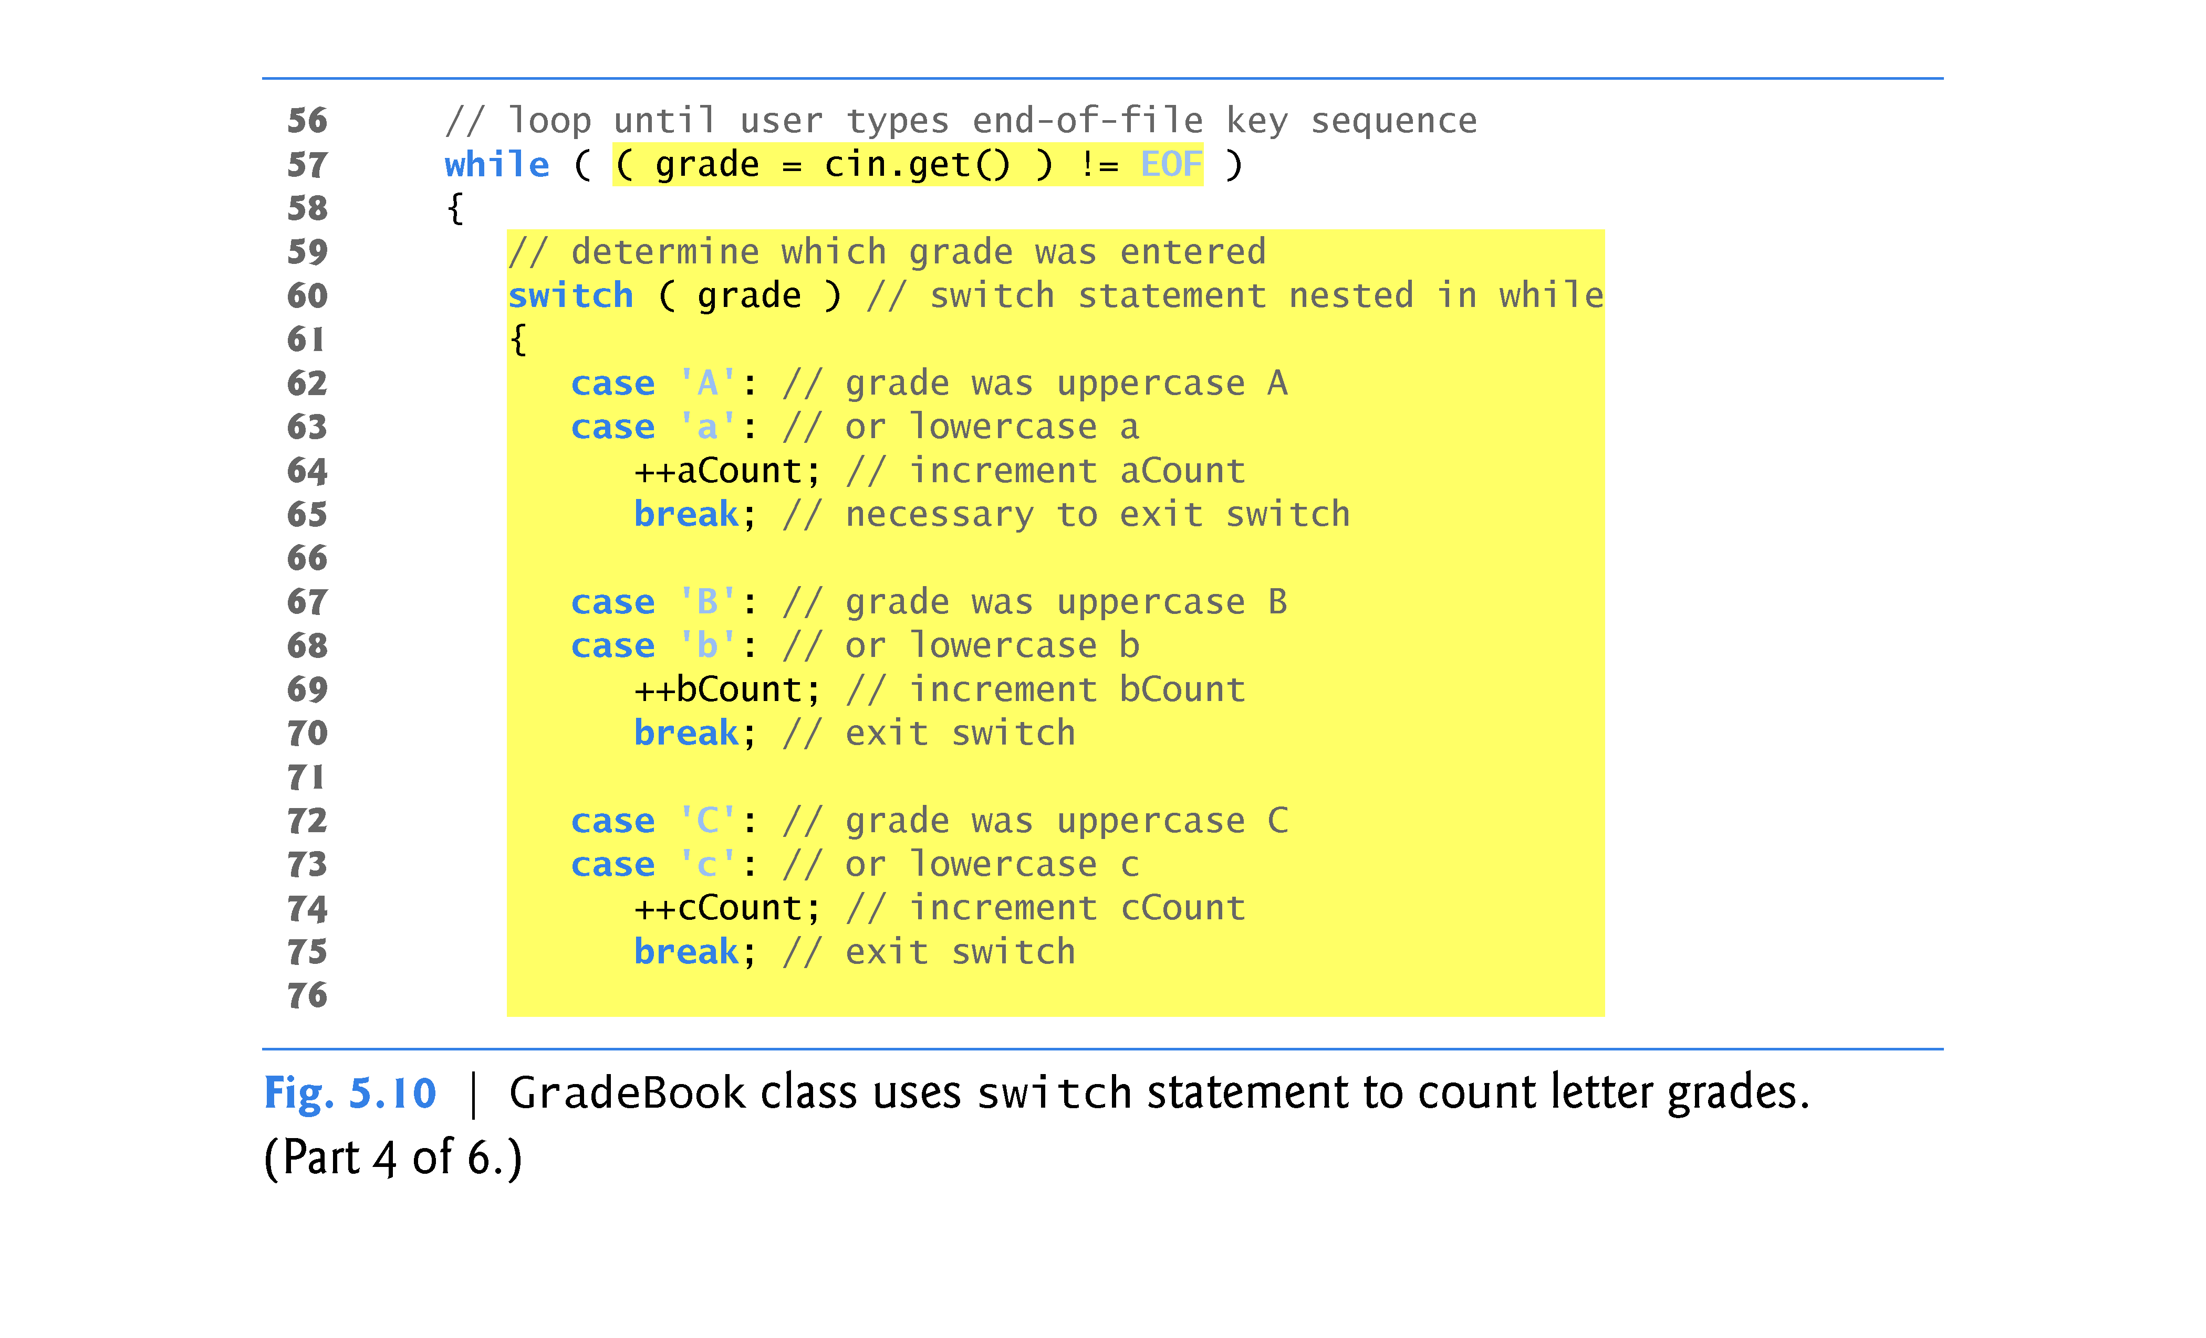

Slide 21
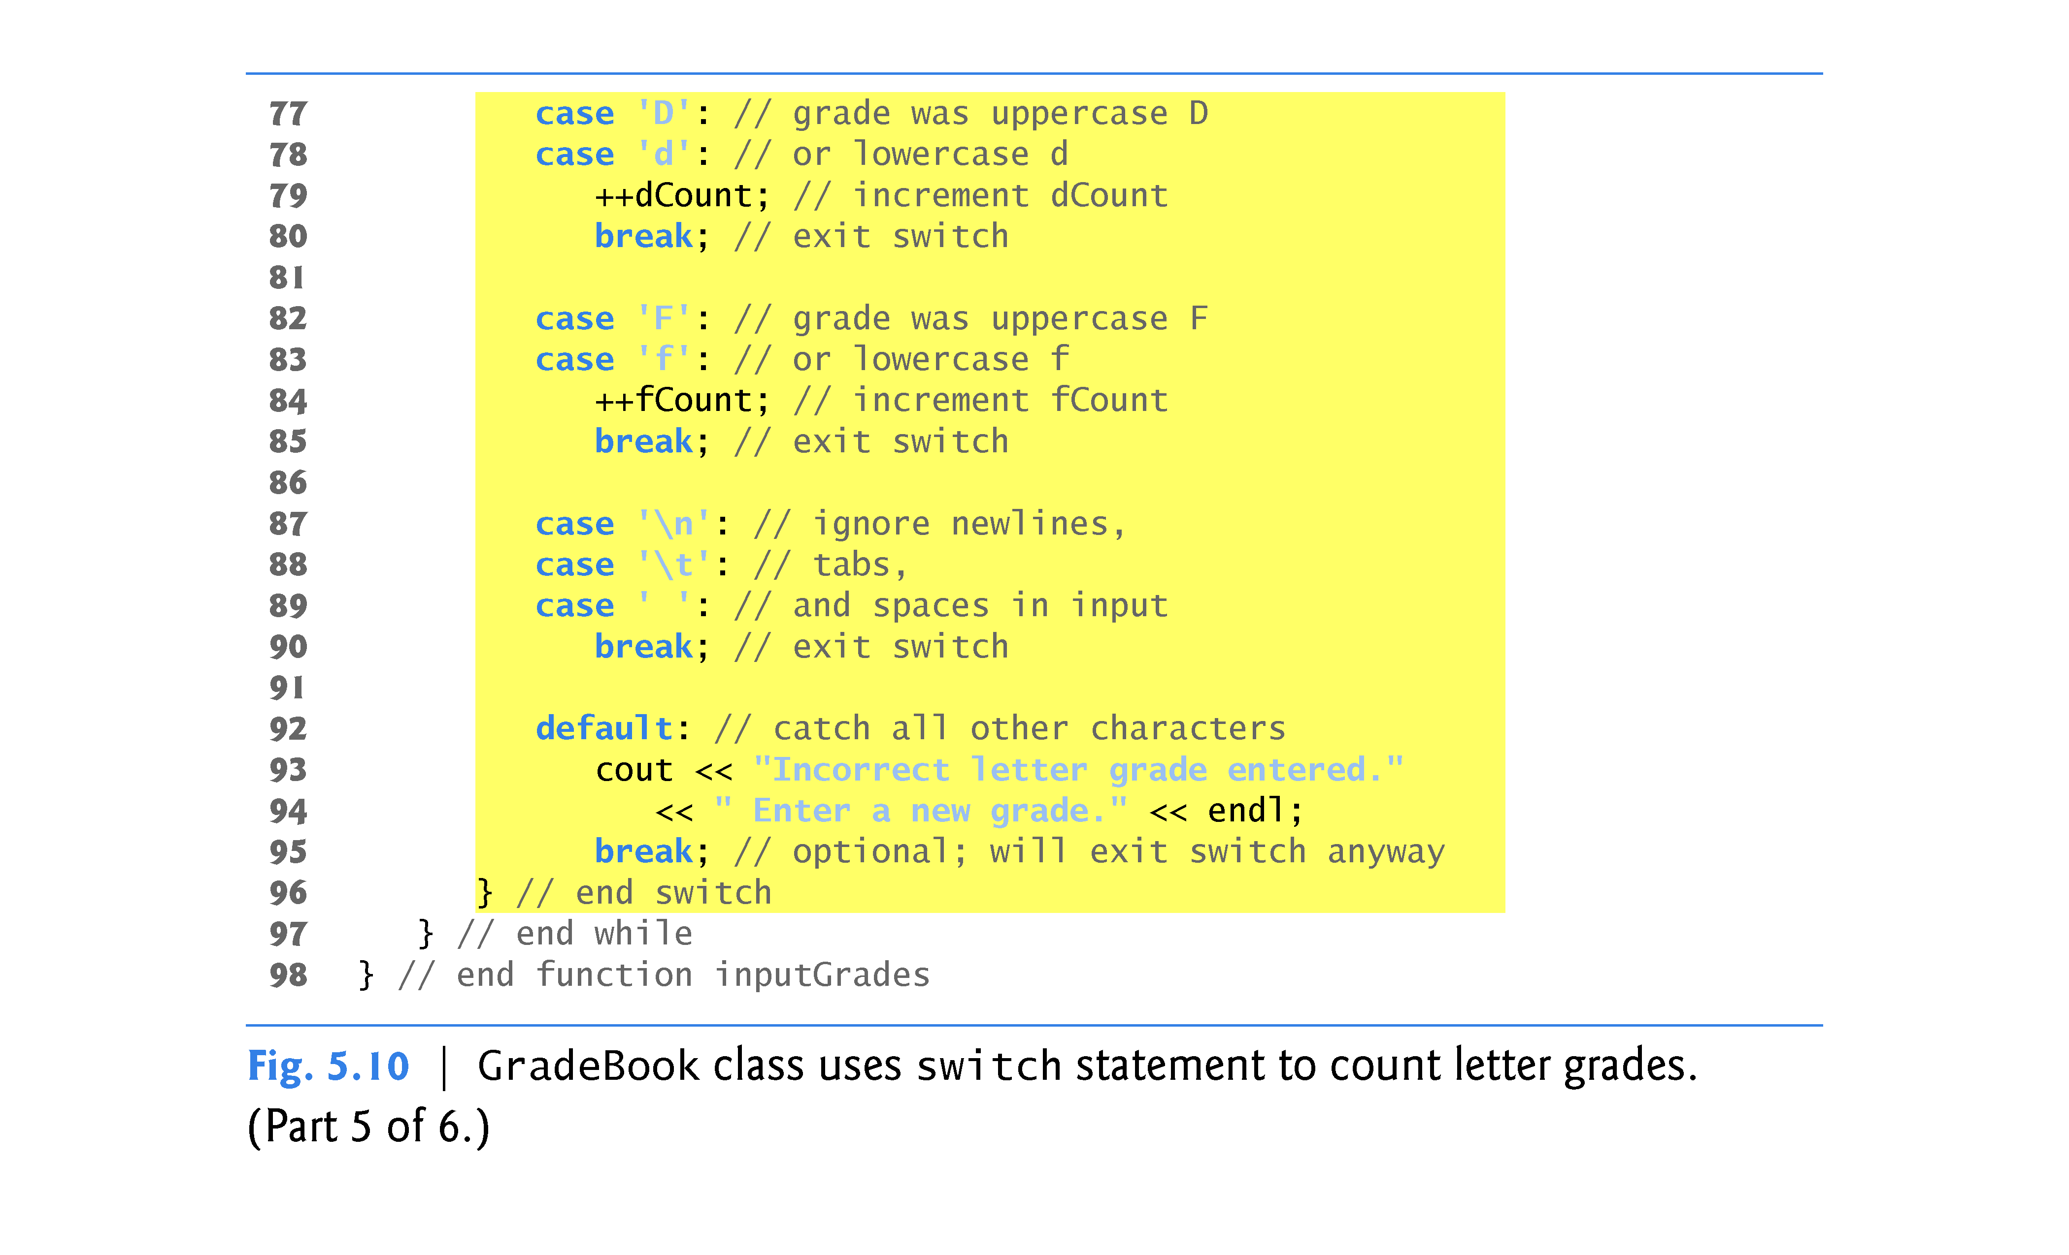

Slide 22
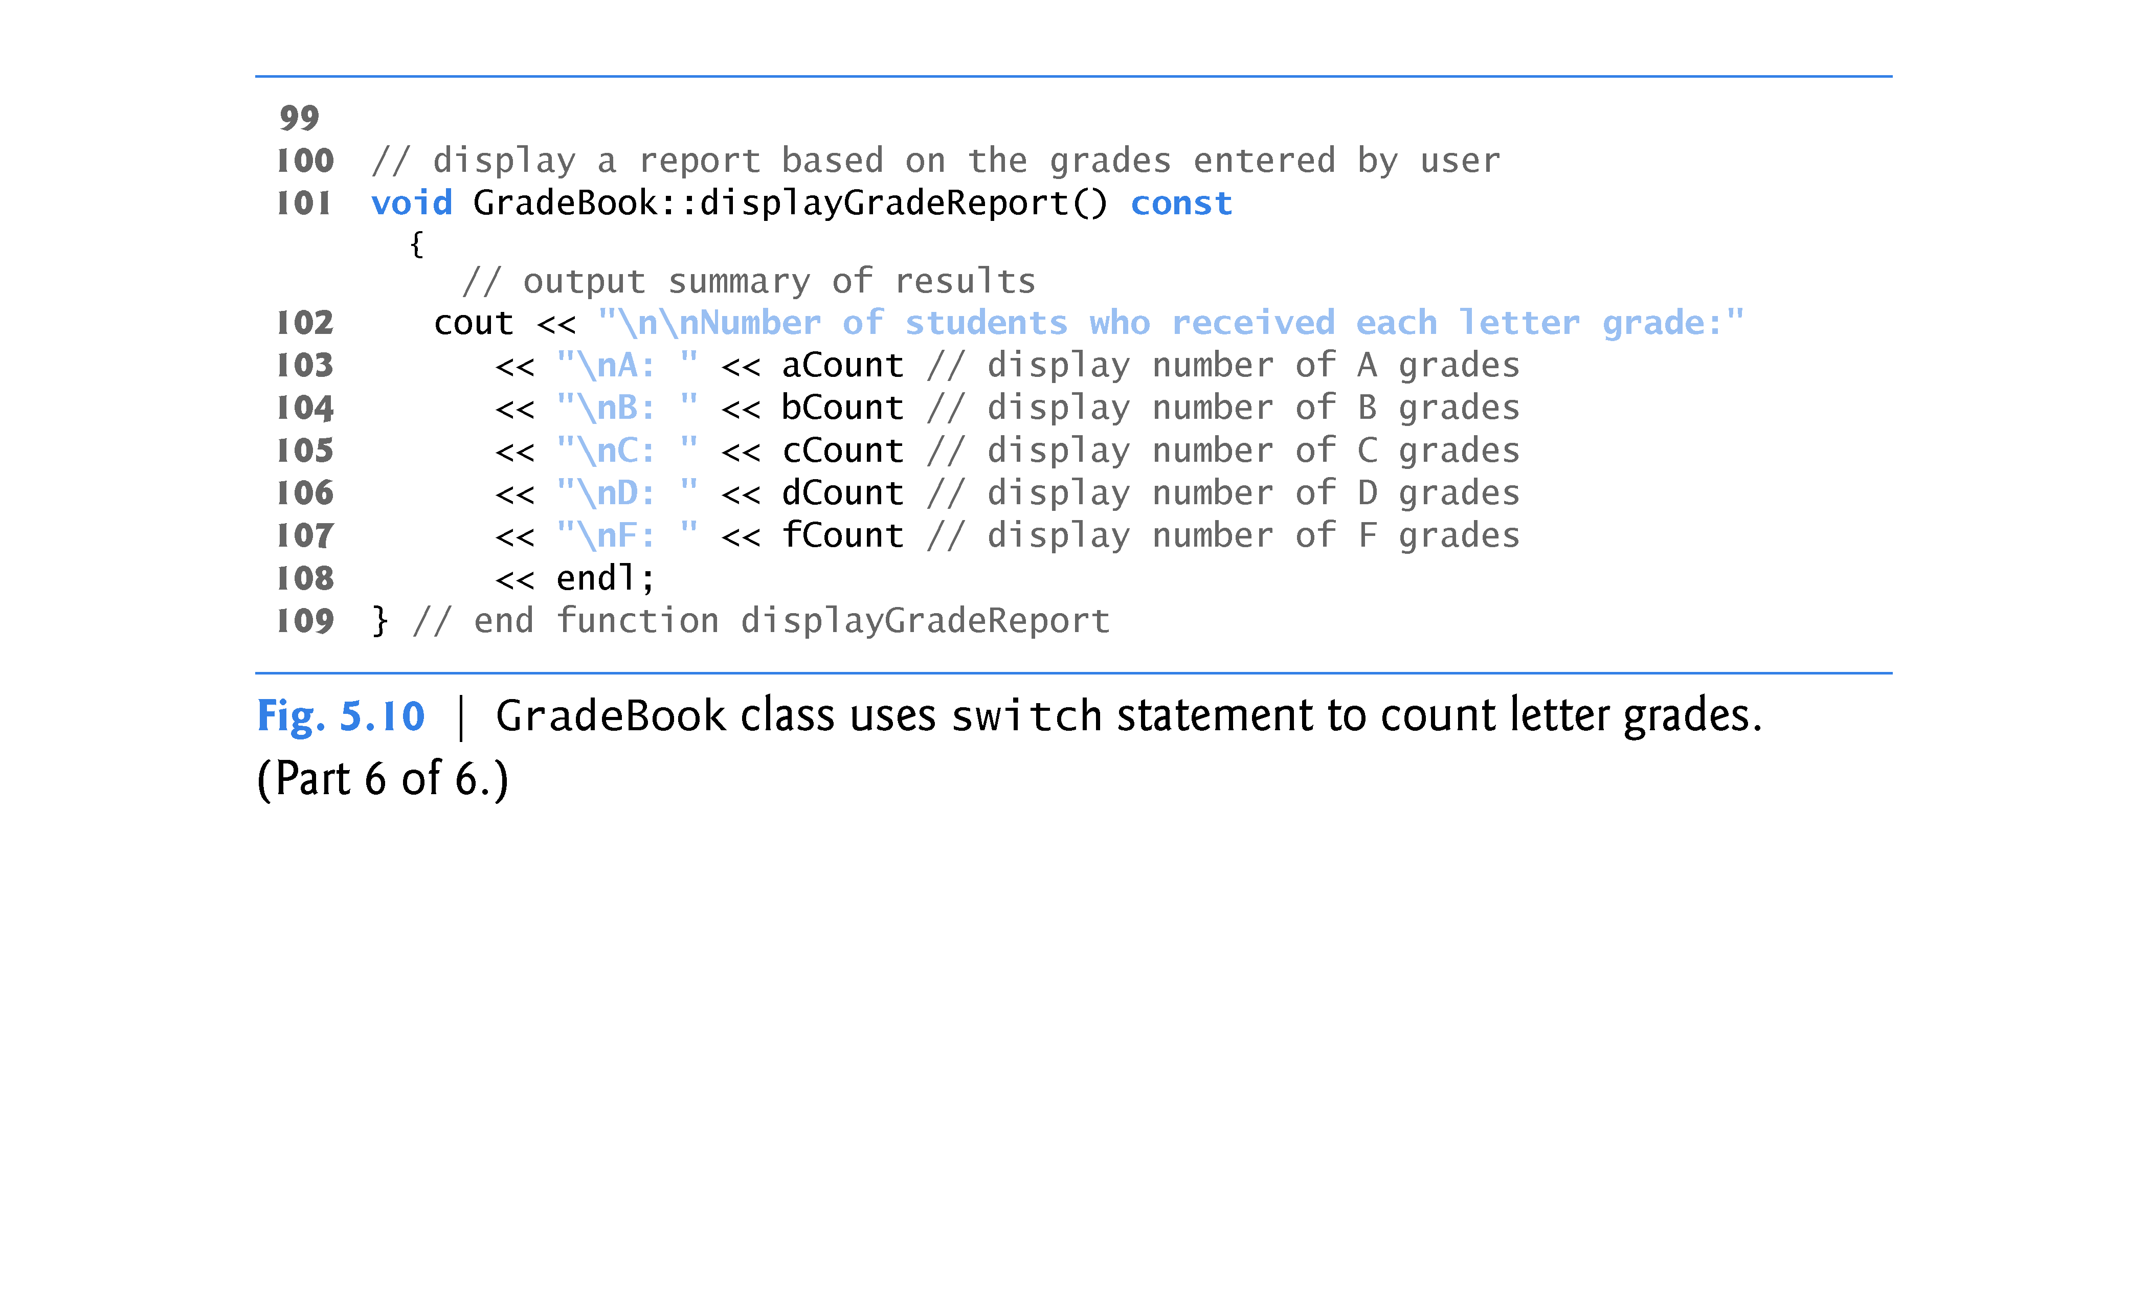

Slide 23
5.6 switch Multiple-Selection Statement (cont.)
Reading Character Input
The cin.get() function reads one character from the keyboard.
Normally, characters are stored in variables of type char; how-ever, characters can be stored in any integer data type, because types short, int , long and long long are guaranteed to be at least as big as type char.
Can treat a character either as an integer or as a character, depending on its use.
For example, the statement
cout << "The character (" << 'a' << ") has the value " << static_cast< int > ( 'a' ) << endl;
prints the character a and its integer value as follows:
The character (a) has the value 97
The integer 97 is the character’s numerical representation in the computer.

Slide 24
5.6 switch Multiple-Selection Statement (cont.)
switch Statement Details
The switch statement consists of a series of case labels and an optional default case.
When the flow of control reaches the switch, the program evaluates the expression in the parentheses.
The controlling expression.
The switch statement compares the value of the controlling expression with each case label.
If a match occurs, the program executes the statements for that case.
The break statement causes program control to proceed with the first statement after the switch.

Slide 25
5.6 switch Multiple-Selection Statement (cont.)
Listing cases consecutively with no statements between them enables the cases to perform the same set of statements.
Each case can have multiple statements.
The switch selection statement does not require braces around multiple statements in each case.
Without break statements, each time a match occurs in the switch, the statements for that case and subsequent cases execute until a break statement or the end of the switch is encountered.
Referred to as “falling through” to the statements in subsequent cases.

Slide 26
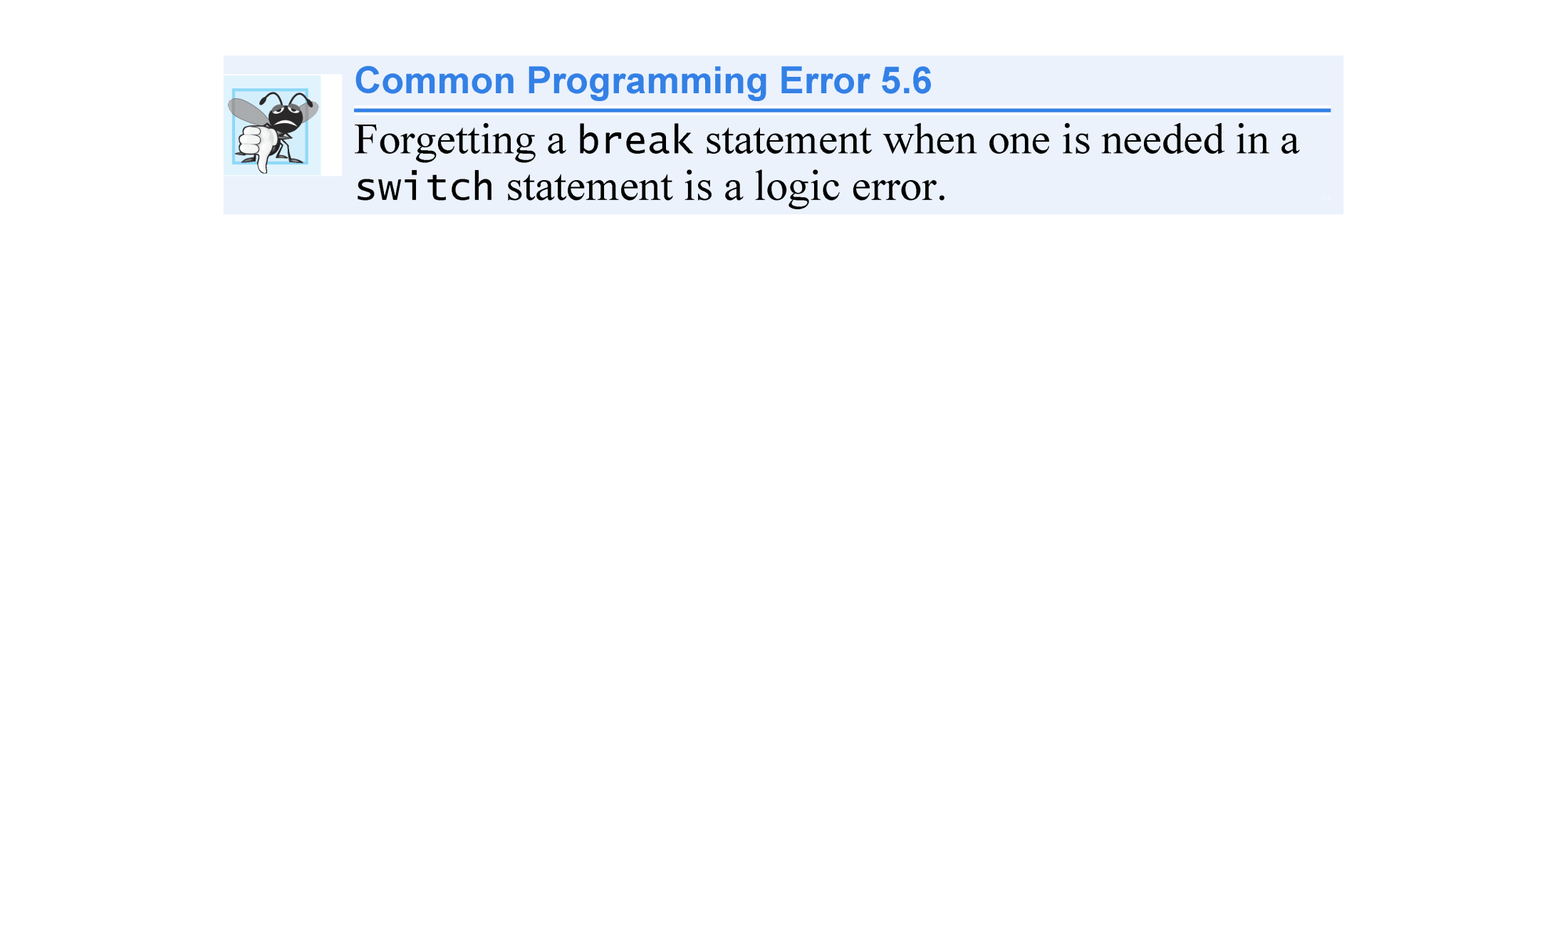

Slide 27
5.6 switch Multiple-Selection Statement (cont.)
Providing a default Case
If no match occurs between the controlling expression’s value and a case label, the default case executes.
If no match occurs in a switch statement that does not contain a default case, program control continues with the first statement after the switch.

Slide 28
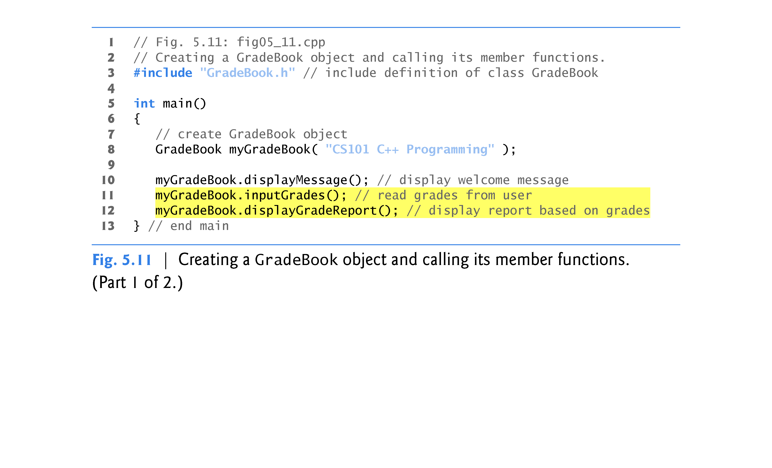

Slide 29
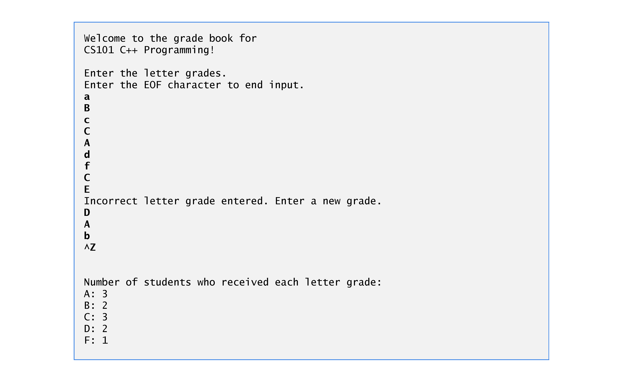

Slide 30
5.7 break and continue Statements
break Statement
The break statement, when executed in a while, for, do…while or switch statement, causes immediate exit from that statement.
Program execution continues with the next statement.
Common uses of the break statement are to escape early from a loop or to skip the remainder of a switch statement.
Figure 5.13 demonstrates the break statement (line 13) exiting a for repetition statement.

Slide 31
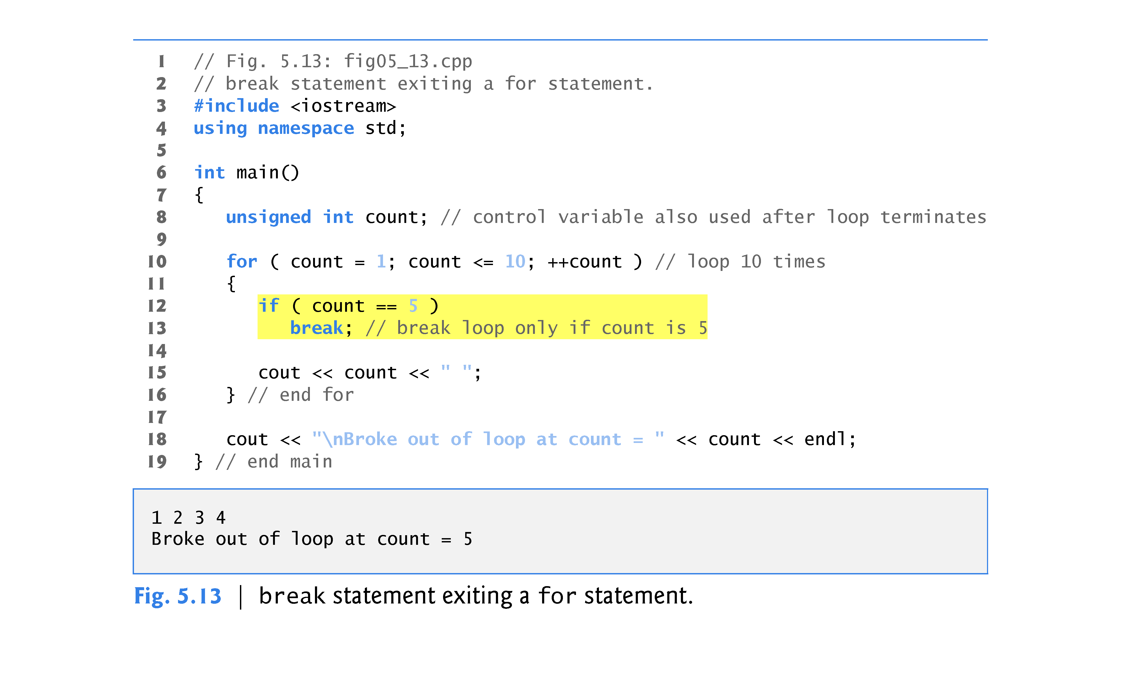

Slide 32
5.7 break and continue Statements (cont.)
The continue statement, when executed in a while, for or do…while statement, skips the remaining statements in the body of that statement and proceeds with the next iteration of the loop.
In while and do…while statements, the loop-continuation test evaluates immediately after the continue statement executes.
In the for statement, the increment expression executes, then the loop-continuation test evaluates.

Slide 33
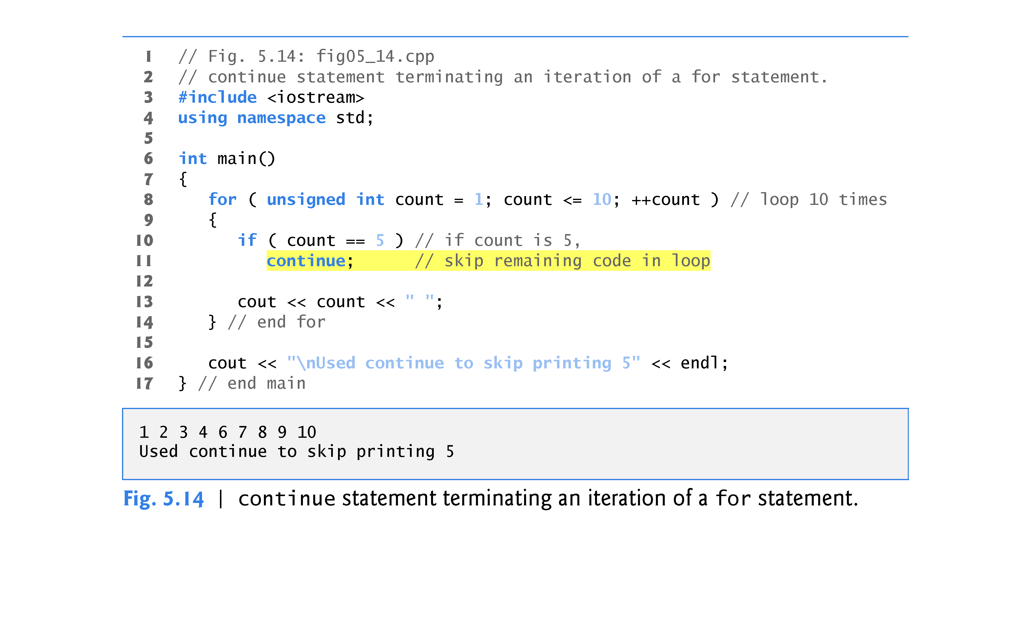

Slide 34
5.8 Logical Operators
C++ provides logical operators that are used to form more complex conditions by combining simple conditions.
The logical operators are && (logical AND), || (logical OR) and ! (logical NOT, also called logical negation).

Slide 35
5.8 Logical Operators (cont.)
Logical AND (&&) Operator
The && (logical AND) operator is used to ensure that two conditions are both true before we choose a certain path of execution.
The simple condition to the left of the && operator evaluates first.
If necessary, the simple condition to the right of the && operator evaluates next.
The right side of a logical AND expression is evaluated only if the left side is true.

Slide 36
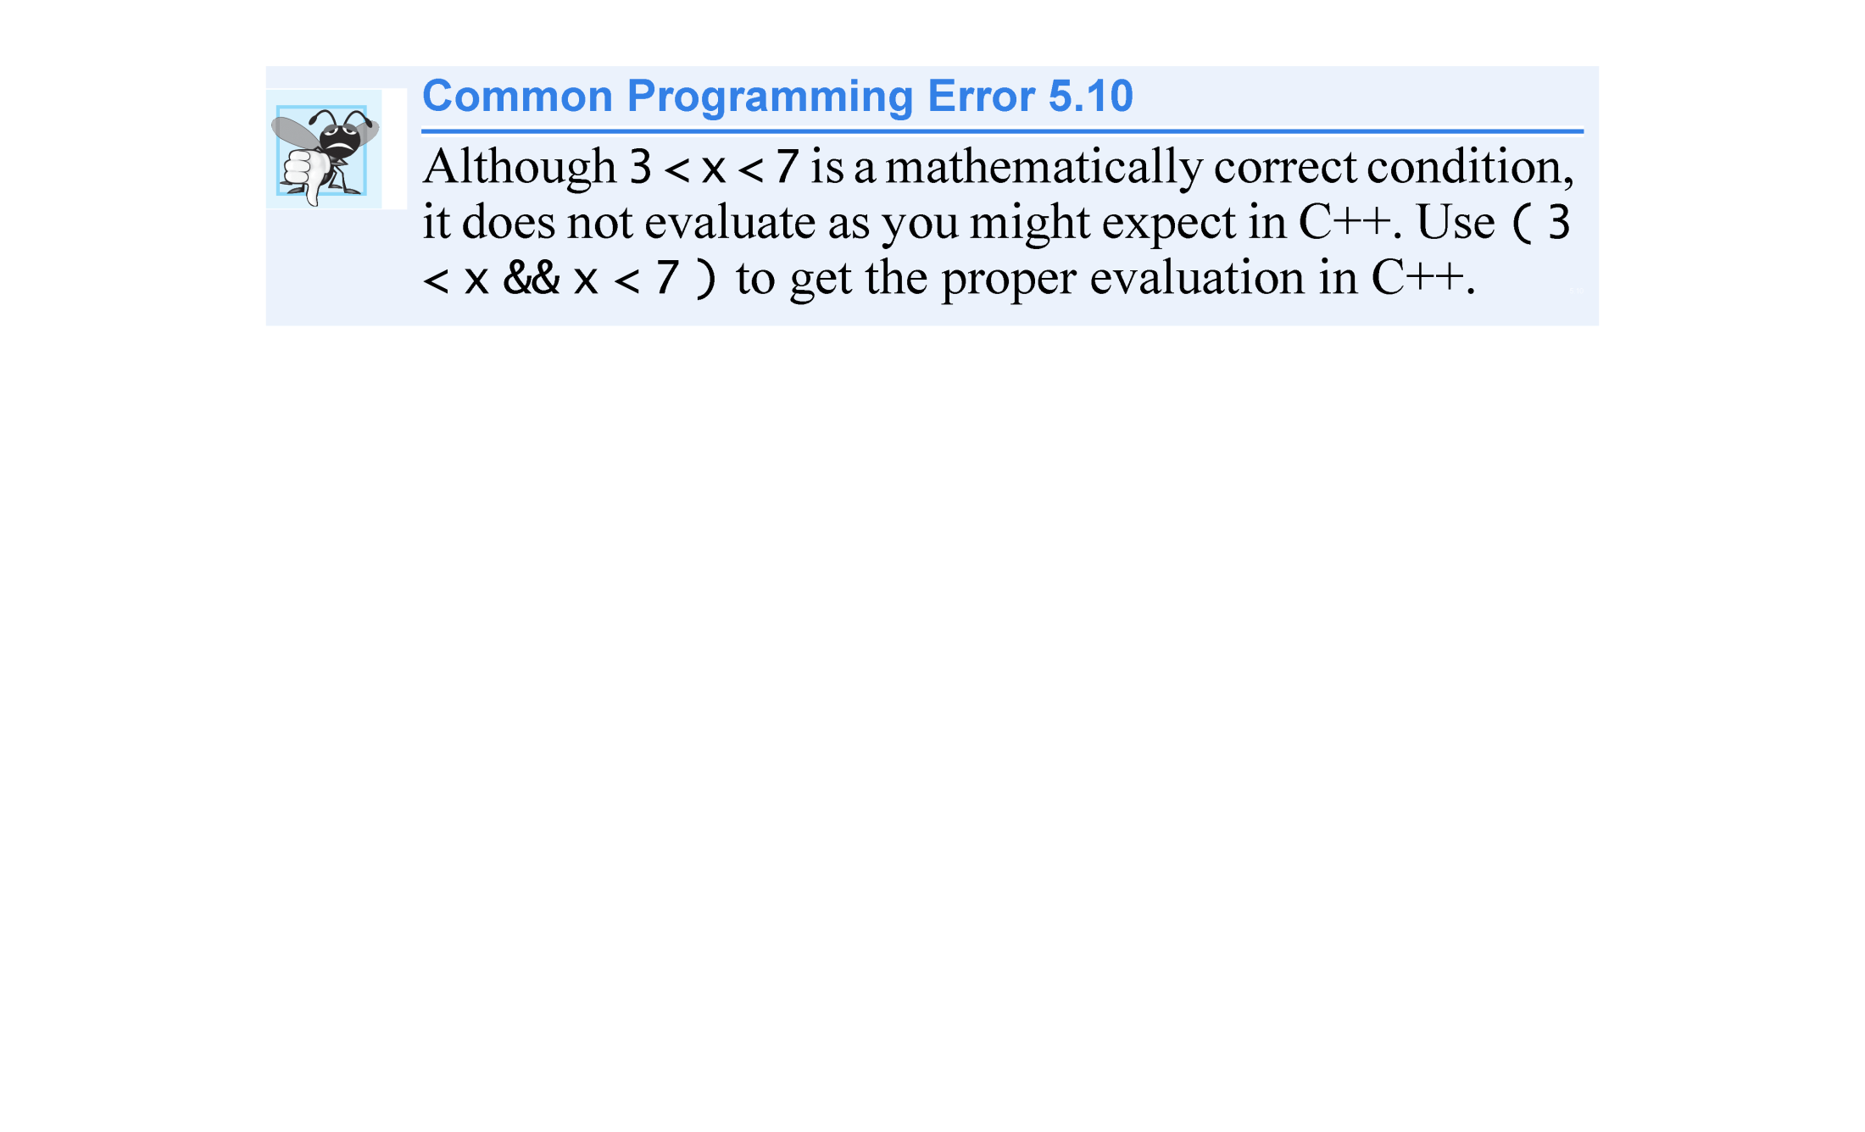

Slide 37
5.10 Logical Operators (cont.)
Figure 5.15 summarizes the && operator.
The table shows all four possible combinations of false and true values for expression1 and expression2.
Such tables are often called truth tables.
C++ evaluates to false or true all expressions that include relational operators, equality operators and/or logical operators.

Slide 38
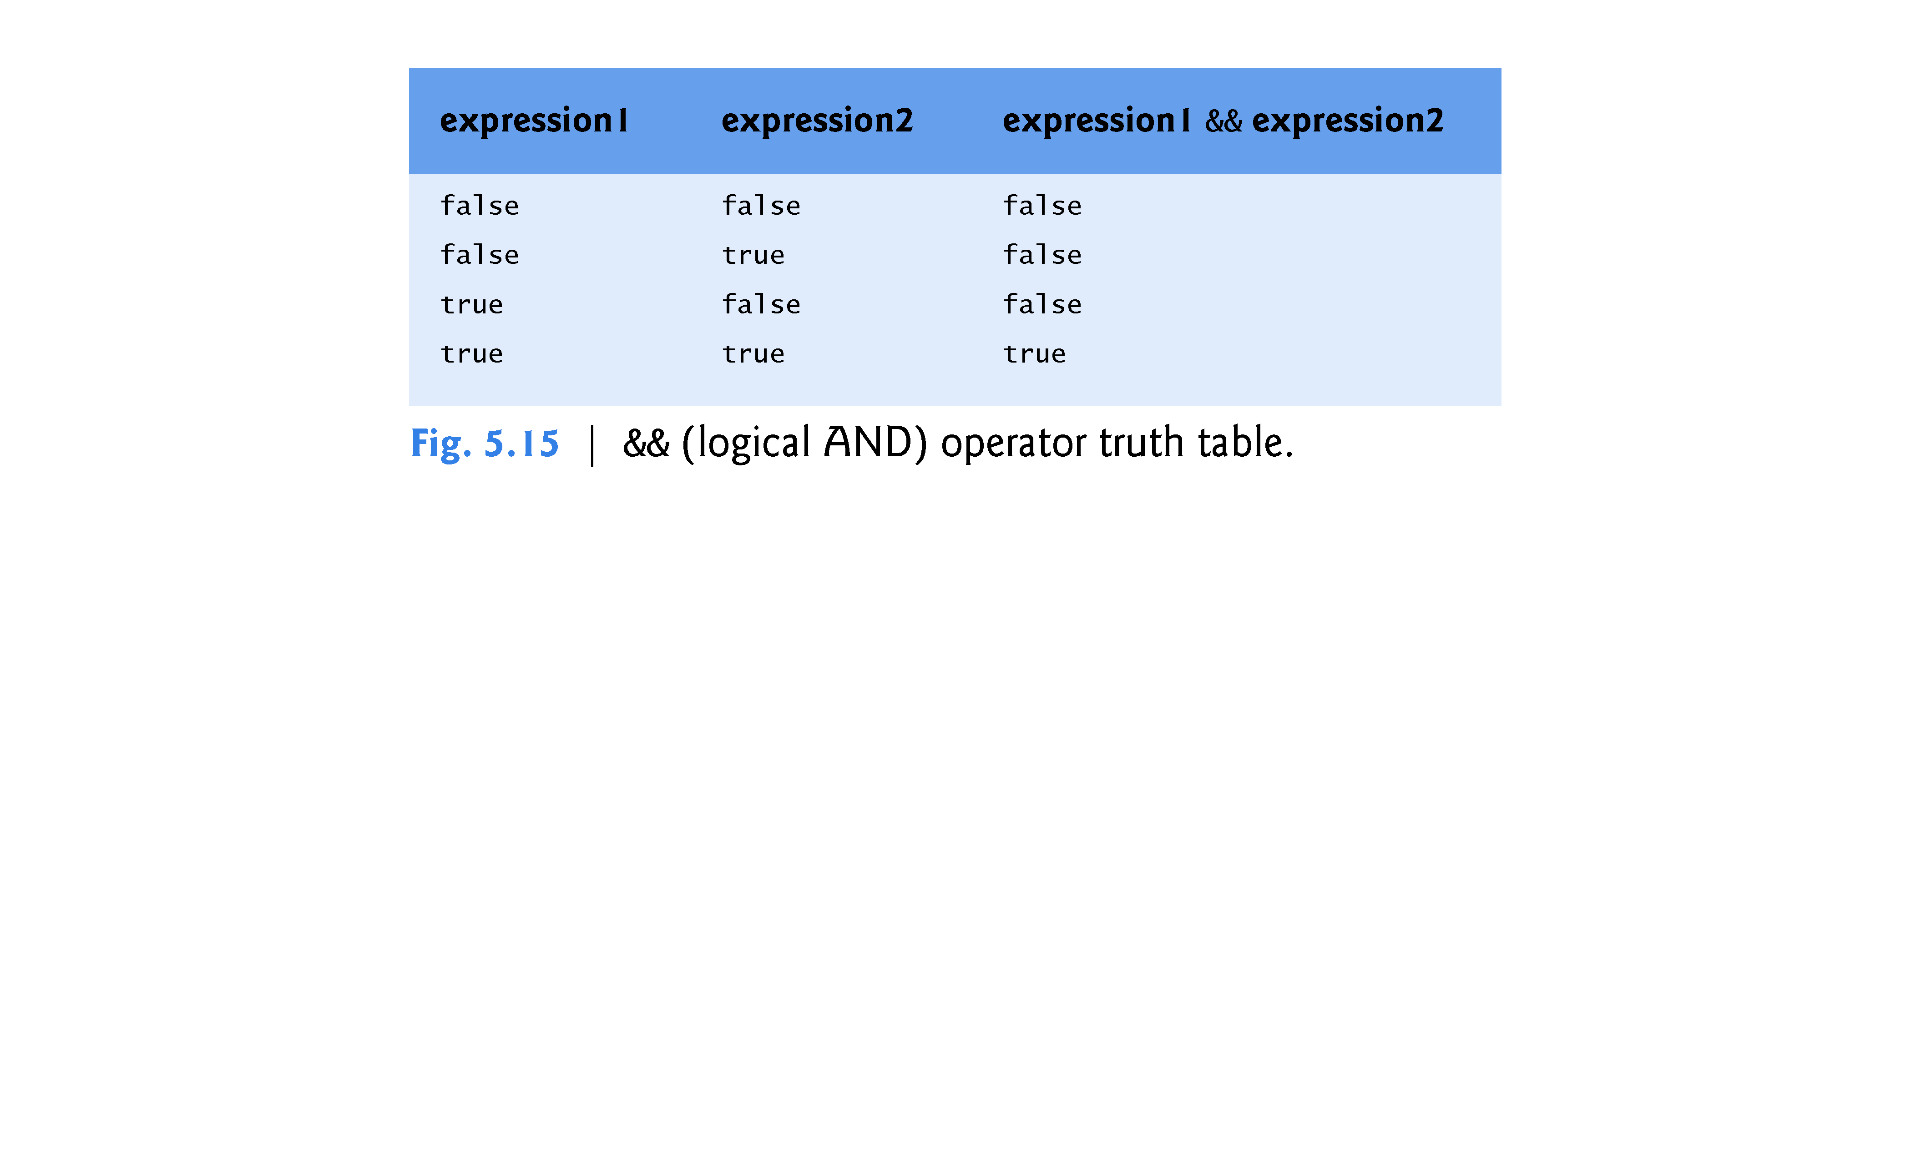

Slide 39
5.8 Logical Operators (cont.)
Logical OR (||) Operator
The || (logical OR) operator determines if either or both of two conditions are true before we choose a certain path of execution.
Figure 5.16 is a truth table for the logical OR operator (||).
The && operator has a higher precedence than the || operator.
Both operators associate from left to right.
An expression containing && or || operators evaluates only until the truth or falsehood of the expression is known.
This performance feature for the evaluation of logical AND and logical OR expressions is called short-circuit evaluation.

Slide 40
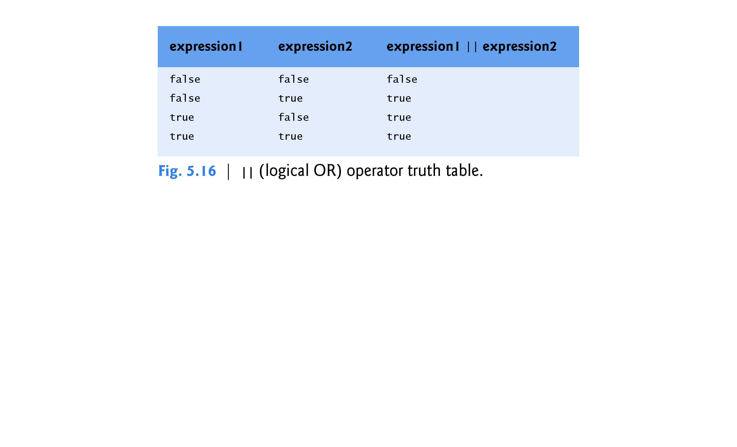

Slide 41
5.8 Logical Operators (cont.)
Logical Negation (!) Operator
C++ provides the ! (logical NOT, also called logical negation) operator to “reverse” a condition’s meaning.
The unary logical negation operator has only a single condition as an operand.
You can often avoid the ! operator by using an appropriate relational or equality operator.
Figure 5.17 is a truth table for the logical negation operator (!).

Slide 42
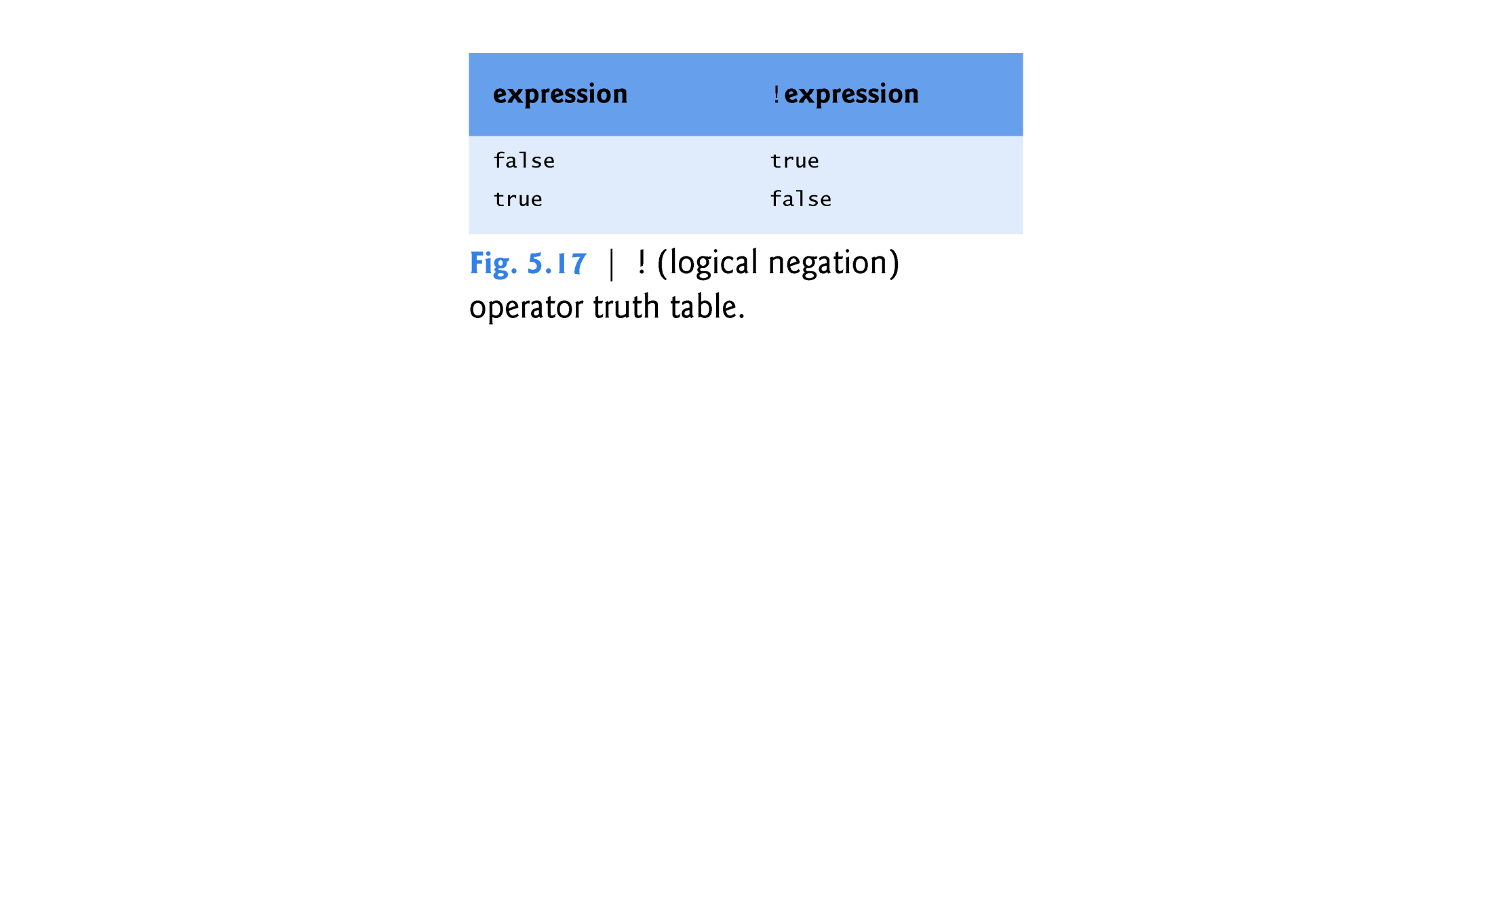

Slide 43
5.9 Confusing the Equality (==) and Assignment (=) Operators
Accidentally swapping the operators == (equality) and = (assignment).
Damaging because they ordinarily do not cause syntax errors.
Rather, statements with these errors tend to compile correctly and the programs run to completion, often generating incorrect results through runtime logic errors.
[Note: Some compilers issue a warning when = is used in a context where == typically is expected.]
Two aspects of C++ contribute to these problems.
One is that any expression that produces a value can be used in the decision portion of any control statement.
The second is that assignments produce a value—namely, the value assigned to the variable on the left side of the assignment operator.
Any nonzero value is interpreted as true.

Slide 44
5.11 Confusing the Equality (==) and Assignment (=) Operators (cont.)
lvalues and rvalues
Variable names are said to be lvalues (for “left values”) because they can be used on the left side of an assignment operator.
Constants are said to be rvalues (for “right values”) because they can be used on only the right side of an assignment operator.
Lvalues can also be used as rvalues, but not vice versa.

